Slide 1

EMT Just In Time Training Modules, COVID-19
Team Security

Slide 2

Session Outcomes
Outline relevant Duty of Care policies and the EMT organization’s degree of risk appetite in respect of its personnel working in surge roles
Identify the channels for reporting security concerns when operating in COVID affected communities
List the key components of a security plan, including specific planning for hibernation and extraction of personnel due to escalating security risks
Apply techniques for reducing staff exposure to criminality when surged into new surroundings
Explain how crowd management principles can be applied to prevent and defuse gatherings of people

Slide 3
What’s Not Covered Here
Specific protective measures relating to infectious disease
Rather, the focus here is on other security threats that, in some local contexts, have been exacerbated by the emergence of a pandemic

Slide 4
Who is responsible for the security of EMT personnel while working as surge support in the COVID response?
?
The primary responsibility for the security and protection of relief workers, their dependents and assets rests with
the host government

Slide 5
Additional considerations which complicate Duty of Care responsibilities
International deployment
Overwhelmed national capacity
Variations in approach between local health facilities
Non-medical support staff may belong to different parental organisations
In conflict settings, host authorities may be a source of threat

Slide 6
Conclusion:
In the absence of a comprehensive, systemic approach to Duty of Care, the EMT organisation must have a robust set of security procedures and measures of its own in place, adapted to the local context.
This is important, whether the individuals are co-located or distributed across more than one facility.
Likewise, individual staff members have a vital role to play, they need to be properly informed and skilled in the individual / team security practices required of them.

Slide 7
The EMT Organisation’s Approach to Duty of Care
[Trainer to insert relevant points here, as befits the organisational approach.
Include the mechanism by which EMT team members are required to report security incidents and near misses – what, how, how urgently, and to whom]

Slide 8
Security planning exercise
“Plans are nothing,
planning is everything”

Slide 9

You are tasked with writing the security plan for your team operations
The majority of your personnel are involved in running a community treatment centre on the outside of the capital city. Additionally, you are providing small numbers of clinicians as surge support to larger hospitals in different parts of the city.
On a single flipchart, list as many elements of your plan as you can
You don’t have to write the plan, just list the essential elements that would be included. Be specific!
Examples:
Immediate steps that staff should take in case of a security incident
Location of assembly areas
Phone numbers of immediate responders etc…

Slide 10
Local time is 1200hrs. Civil unrest has erupted near your community treatment facility between rival groups. Tension is spreading to the outskirts of the city and the government security forces are responding aggressively. You must pass instructions to all teams & staff quickly. To do so, you must have updated staff lists.
Do you have updated staff lists?
If yes: the task takes 1 hr
If no: the task takes 2 hrs
Extra credit: do you have a warden system or information tree?
If yes: the task takes 0 hrs

Slide 11
Your instructions are for people to move to their designated safe areas, as indicated in the security plan
Have you indicated designated safe areas?
If yes: the task takes 1 hr
If no: the task takes 2 hrs

Slide 12
As team members may have to wait in their safe areas for some time, they may need emergency supplies (food, water, medical)
Have emergency supplies been planned for?
If yes: the task takes 1 hr
If no: the task takes 2 hrs

Slide 13
You try to call your HQ but all phone lines are down. You will use the backup means of communications listed in the communications plan.
Do you have a communications plan?
If yes: the task takes 1 hr
If no: the task takes 2 hrs

Slide 14
Instructions from HQ are to evtract/relocate non-essential staff. You will do this in accordance with the evacuation plan.
Do you have an extract/relocation plan?
If yes: the task takes 1 hr
If no: the task takes 2 hrs

Slide 15
Local health providers will need to continue operations. They will do this in accordance with the plan for continuity of operations, which your team will support remotely.
Do you have a plan for continuity of operations?
If yes: the task takes 1 hr
If no: the task takes 2 hrs

Slide 16
A problem has arisen: the primary means of extraction is no longer available. You will have to use an alternative.
Have you identified an alternative means of extraction, including secondary (back up) routes?
If yes: the task takes 1 hr
If no: the task takes 2 hrs

Slide 17
Carrying out the evacuation will require national government coordination (escorts, for example). At a minimum, you will need to know how to contact key officials.
Have you planned for host nation coordination?
If yes: the task takes 1 hr
If no: the task takes 2 hrs

Slide 18
Local news stations are reporting a building collapse in one of the city hospitals causing damage and loss of services. Four of your staff were working there, one of whom has been seriously injured. You want to coordinate her transfer immediately, but do not know which are the safe routes. You plan to consult the map in your security plan.
Does your security plan include a map?
If yes: the task takes 1 hr
If no: the task takes 2 hrs

Slide 19
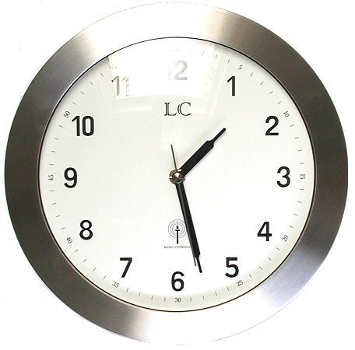
Final time for your team?

Slide 20
Key ingredients: what should a good security plan contain?
Overview of the situation and risk assessment
Contact info for key personnel
Updated staffing lists
A communications plan
Team security standard operating procedures
Maps, safe routes & safe houses
Emergency assembly areas
Host nation liaison
Medical support plan
Plans for specific contingencies - including extraction, hibernation and continuity of operations

Slide 21
Dealing with criminal threats
Criminality is a constant threat in any society and doesn’t disappear during times of pandemics.
Some criminal elements may seek to intentionally exploit the situation e.g. identity fraud, domestic or gender-based violence.
As basic resources (e.g. food) grow short, increase in petty theft, looting or other unplanned acts out of desperation.
EMT personnel must therefore act with continued situational awareness – this is especially difficult when tired, stressed and (for surge responders) when operating in a local context that was unknown to them previously.

Slide 22
Crowd management for EMTs responding to COVID
Crowd situations can be challenging for health facilities to deal with during sudden onset disasters
However, during the COVID pandemic, the needs and motivation of crowds differ, e.g.:
  Fear and confusion
  Lack of, or conflicting, information
  Increased reports of aggressive behaviour channeled towards foreign relief workers
  Examples of violent tactics used by security forces to enforce lockdown and disperse civil unrest
See the following for latest incident security bulletin:
http://insecurityinsight.org/projects/aid-in-danger/aid-security-and-covid-19

Slide 23
EMT Mobile Operations
You are part of a mobile assessment team who is visiting remote communities to identify their medical needs during the pandemic. The first 3 towns you visit are peaceful and well organised.
However, when you reach the 4th town, word has spread before you and a large gathering of people quickly surround your vehicles. The community leader greets you and explains that the community is in desperate need of relief items (food, clean water, shelter provision) and they have been expecting your arrival to start the distribution.
2. What actions would you follow in this scenario to manage the crowd in terms of:
a. Pre-empt?
b. Defuse?
c. Contain?
Notes:
First of all: Don’t encourage people into crowds unless you can meet their expectations.
Passage of info time critical and to whom (through community leaders, shelter to shelter) Cover what is pertinent to them.
Message – content, timings, consultation.
credibility
equitable distribution
assurance will not miss out.
Quash rumours asap
Identification of subversive elements
Set up favourable conditions – open location for crowds to assemble or channel through wire fencing perhaps, notify security authorities

Slide 24
EMT Fixed Facility Operations
There are 2,000 internally displaced persons (IDPs) currently located in a temporary settlement with a further 300 expected to arrive soon.
It has been advertised to the local population and IDPs that your EMT facility will be arriving to begin patient registration and triage operations on Wednesday morning.
On Tuesday evening, however, you are advised that the numbers for new arrivees were grossly underestimated, and that closer to 3,000 additional IDPs will be showing up for treatment the following morning.
1. Would you go ahead with your medical relief operations on Wednesday?
2. If so, what actions would you follow to manage the crowd in terms of:
a. Pre-empt?
b. Defuse?
c. Contain?
Notes:
First of all: Don’t encourage people into crowds unless you can meet their expectations.
Passage of info time critical and to whom (through community leaders, shelter to shelter) Cover what is pertinent to them.
Message – content, timings, consultation.
credibility
equitable distribution
assurance will not miss out.
Quash rumours asap
Identification of subversive elements
Set up favourable conditions – open location for crowds to assemble or channel through wire fencing perhaps, notify security authorities

Slide 25
A. Preempt
Avoid encouraging people into crowds unless you are sure of meeting their expectations
Plan:
  understand the context and needs of the crowd
  choose appropriate time and location
  plan the physical spacing in waiting areas
  remove dangerous objects
  contingency plans
Rehearse scheduled events
Notes:
Preemptive Stage
1. Plan:
Gather info – Sources – Community leaders, host community, local authy, national staff.
Attitudes/expectations of the people – why are people there (by choice, or trapped), are they motivated to violence or eager to escape the scene.
Plan for worst case scenarios: evacuation of your staff. At what point and how will you disconnect from the situation?
2. Rehearse:
Notify and involve relevant authorities eg. Police, local government, UNDSS, private security.
[next slide]

Slide 26
B. Defuse
Avoid entering crowds
Separate leaders where possible to seek win-win solutions
Keep others informed & comfortable during negotiations
Notes:
1) Condsider your own proximity & position. You can only help the situation if you are yourself removed from direct threat.
2) Separate the leaders; you can’t negotiate with a crowd. Masses will copy the behaviour of small, influential cohesive sub-groups.
Front and center of the mob/aggressive crowd is usually the highest point of tension. Leaders/excited individ exercising unusual influence upon others will be located here
3) If possible, allow the crowd/mob to drain itself of energy and disperse by itself. If not - negotiate (will be covered in separate session). However, a basic aim is to find win-win solutions.
4) Attend to the information and physical needs of the masses. Monitor for other subversions. Get them to sit down if possible – no one ever sits down to throw something. Don’t be afraid to lower your eye level.
[next slide]

Slide 27
C. Contain
As medical relief teams, we should be gone by this stage. Recognise the escalation signs as civil unrest increases, and make decisive decisions
Ensure all team members are clear on the exit plan – when and how to disconnect
Advance planning and liaison with local security forces is needed
Be aware that different security forces will respond in a variety of ways
Notes:
Goes back to Preempt stage. Eg. In Darfur, Registrations were not always done in close cooperation with local police/UN secy forces. Therefore in mid – late 2005, efforts were made to involve a coordinated approach to security involving UNDSS, WFP secy, local police.
2) Police RoEs versus military. Emphasis on the degree to which a response is proportional to the threat. Exception: highly trained military force in support of law enforcement eg. British Army in Northern Ireland. But this was only born out of huge mistakes and experience – Bloody Sunday.
3) Be quick to spot the turning signs – as discussed earlier. Get audience to quickly re-cap.
4) Recognise your own limits and pre-arange when / how you extract.
[next slide]

Slide 28

Summary
• Governments have overall Duty of Care responsibility but, especially during pandemics, this is a challenge, and therefore everyone has a role to play in contributing to security risk management.
• Management has additional responsibilities, these must be applied even if EMT personnel are seconded to multiple health facilities.
• One of the key tools is to develop a practical security plan that is tailored to the risks present in the local environment. Security plans are strongest when developed as a collective – management should involve and inform team members as much as possible.
• Specific threats in times of pandemics don’t disappear. The EMT organisation should have specific measures in place to deal with criminality and crowd unrest.

Slide 29
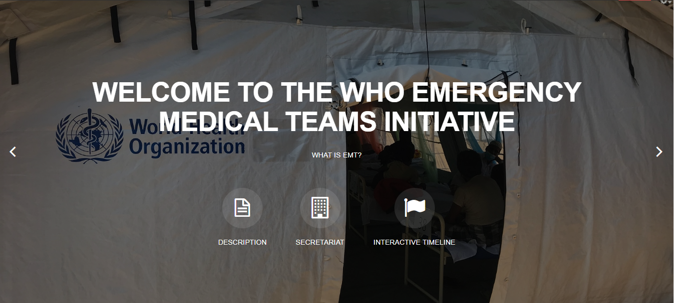
Thank you
Any questions?
For more…
http://extranet.who.int/emt/
EMTeams@who.int

